Slide 1
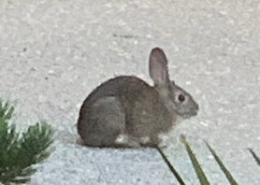
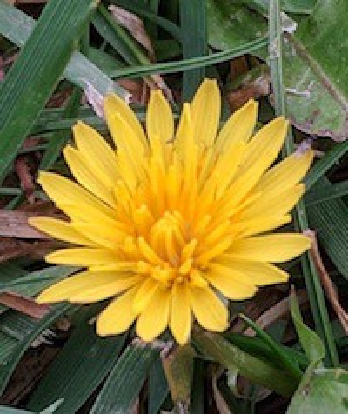
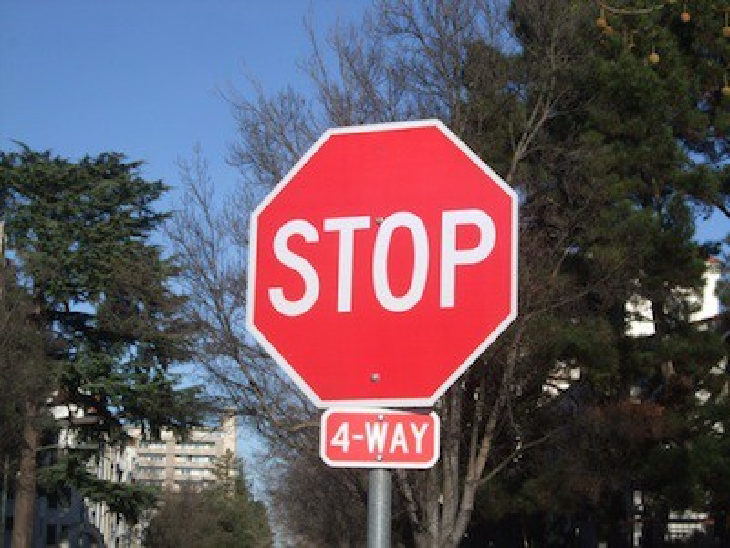
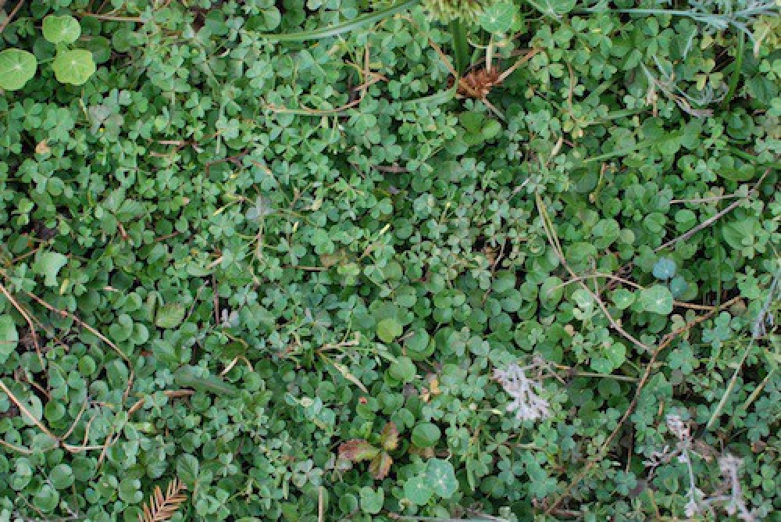

July 12, 2021 Fun with Images! Stanford University + Ohlone College
CS Bridge 2021

Slide 2
Install Pillow and simpleimage.py
Install Pillow if needed (probably not needed?), from PyCharm Terminal tab
On PC: py –m pip install Pillow (note capital P in Pillow)
On Mac: python3 –m pip install Pillow (or just “pip install Pillow”)
NOTE: This requires downloading simpleimage.py into your PyCharm project directory to get access to the SimpleImage code.
SimpleImage was developed at Stanford by Nick Parlante
Some images are helpful too – or you can use your own.
Place image files in “images” directory within PyCharm project

Slide 3
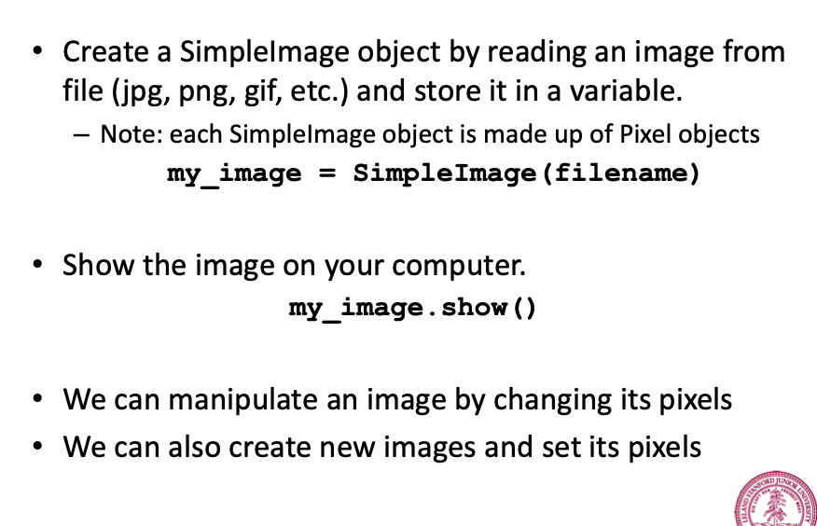
SimpleImage Functions

Slide 4
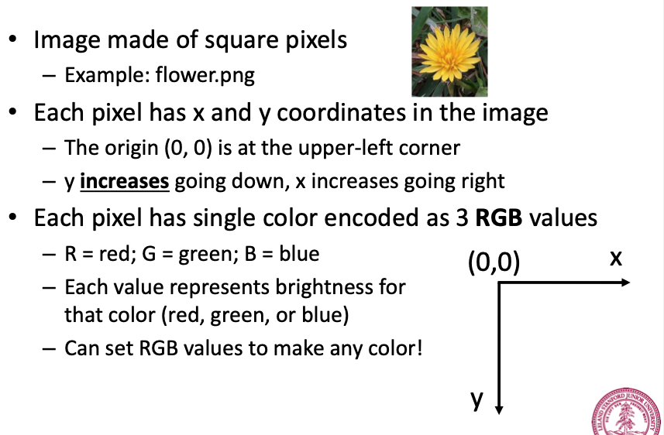
What is an Image?

Slide 5
Chat Question: How many pixels in an 800x600 image?
Please answer the question in chat:
How many pixels in an image that is 800 wide by 600 high?
A: 800
B: 1400 (800 + 600)
C: 480,000 (800 times 600)
D: 1,440,000 (800 times 600 times 3 (R, G, B))
E: 7,680,000 (800 times 600 times 16 colors)

Slide 6
Chat Question: How many colors can a pixel have in theory?
Please answer the question in chat:
A pixel can theoretically have how many different colors?
A: 16
B: 128
C: 1024
D: 1,048,576
E: 16,777,216
F: Infinite

Slide 7
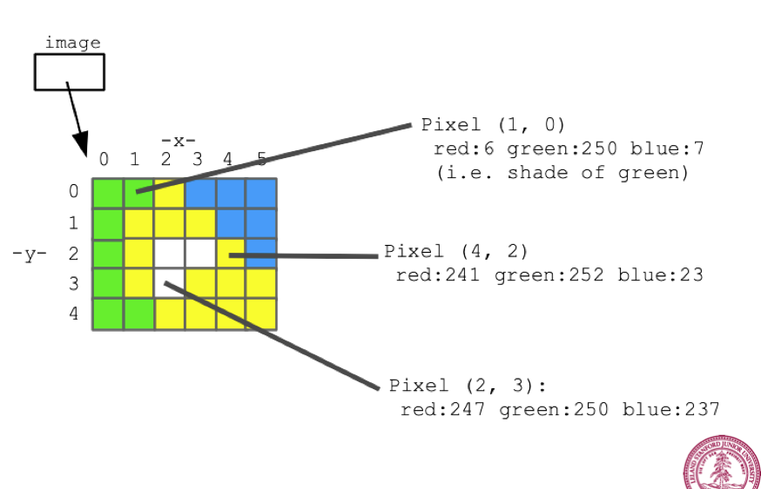
What is a Pixel?
A pixel has x and y coordinates, and R, G, B values each from 0 to 255.
RGB (255,255,255) is white. RGB (0, 0, 0) is black. RGB (255, 0, 0) is red. RGB (127,127,127) is grey.

Slide 8
Properties of Images and Pixels
Each SimpleImage image has properties you can access:
image.width, image,height
Each pixel in an image also has properties:
pixel.x, pixel.y, pixel.red, pixel.green, pixel.blue
(red, green, blue are RGB integer values from 0 to 255)
Higher R, G or B values means more of that color in pixel.
RGB (255, 255, 255) is white
RGB (0, 0, 0) is black
RGB (255, 0, 0) is red
RGB (127, 127, 127) is grey

Slide 9
RGB background, history, trivia
R, G, B (red, green, blue) started with color photography in the 1800s
Used in television, cameras, video technology in 1900s
First used in computers in 1970s
Did not always have as many as 256 int values for R, G, B (0-255), became common in 1980s
But RGB (0-255) has been standard in computers, etc. for a long time now
Usually referenced as hexadecimal values, including in HTML/CSS
For example, if Red = 7, Green is 16, Blue is 255 then RGB is hex #0710FF
256 (2 ** 8) cubed gives 2**24 values, which is over 16 million
Over 16 million colors is far more than eye can differentiate

Slide 10




RGB flag, etc. colors
USA Flag RGB: Red=#B22234, White=#FFFFFF Blue=#3C3B6E
Canada Flag: Red=#FF0000, White=#FFFFFF
Buffalo Bills NFL team Red #C60C30, Blue #00338D
Philippine flag red #CE1126, Vietnam #DA251D, UK #C8102E
Turkish flag Red #E30A17, White=#FFFFFF
Often White == White, usually Red != Red
Most “red” in flags different, but Canada == Indonesia == China

Slide 11

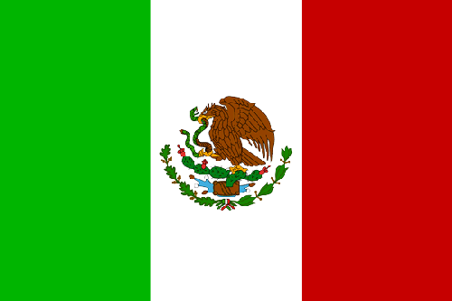
RGB colors
Philippines red #CE1126 == Mexico #CE1126 “Philippine red”
Designers, UX, UI dev’s, Web masters care about exact colors
Specific RGB for teams, colleges, companies
https://usteamcolors.com for US sports teams
Ohlone College official green RGB is (81, 145, 54) hex #519136
Ohlone gold is (215, 199, 0) hex #D7A900
Stanford athletic cardinal red is (140, 21, 21) #8C1515
View Source on https://gostanford.com/ you’ll see 8C1515
View Source https://stanford.zoom.us/ you’ll see 8C1515
Google “online rgb” or rgb, etc to find online RGB color charts

Slide 12
Fun Playing with Images!
THESE ARE EXAMPLES TO PLAY WITH AND EXPERIMENT WITH AS YOU WOULD LIKE
These are on Ed, along with the required images as well. Might be useful for projects.
mirror.py – double your burrito! Make a mirrored copy next to original burrito
imageexamples.py – mess with the flower in various ways: b/w, darker, negative, border
greenscreen.py – replace any predominantly red pixel with corr. pixel from different image
simpleimage.py was developed at Stanford by Nick Parlante – put in PyCharm project

Slide 13
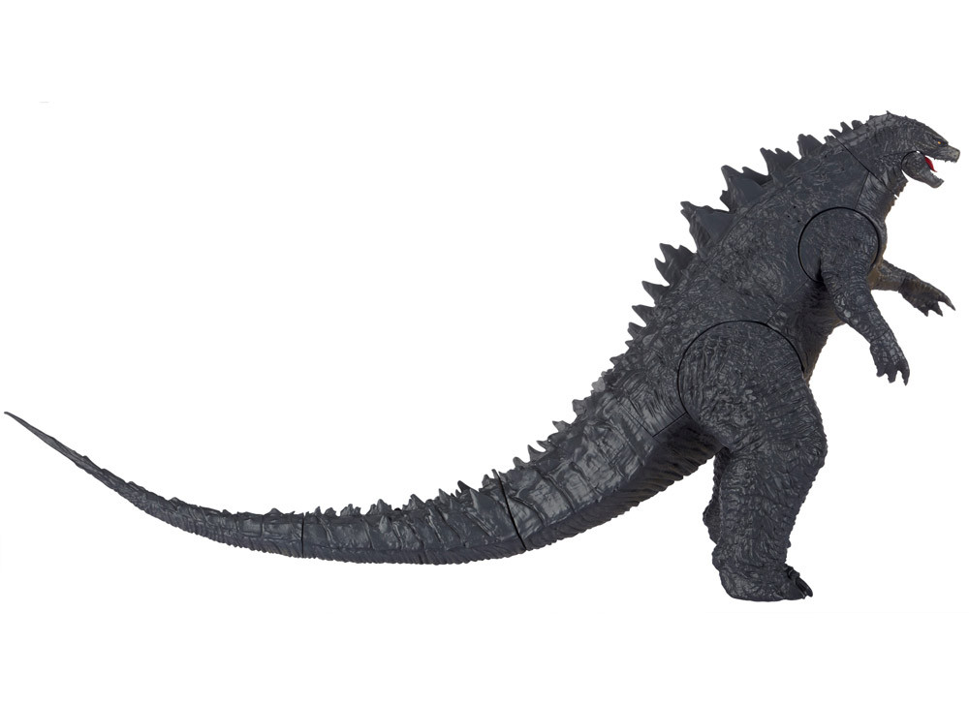
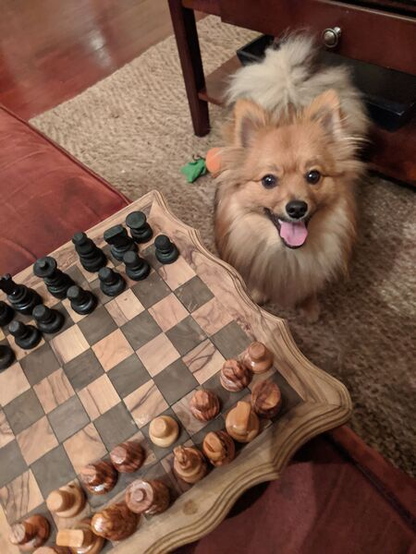
A Kinder and Gentler Godzilla
Godzilla has become a good Python programmer in this course
Godzilla successfully completed his anger management course
Godzilla has become a vegetarian pacifist, and feels misunderstood
Godzilla taught Simba the smart dog to play chess, code Python

Slide 14

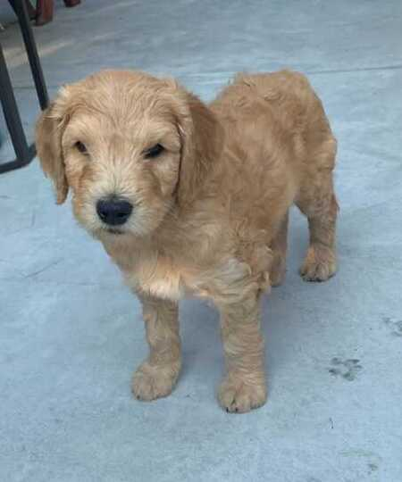
Godzilla’s CS Bridge Project
Godzilla has become good friends with Karel and Ajax
Godzilla thinks he can teach Ajax some dog tricks
Karel has doubts, thinks Ajax is young and not as smart as Simba
But Godzilla is confident he can do it
Godzilla plans to be a professional dog trainer
Godzilla’s project: dogtrainer.py

